Slide 1
What Next

Slide 2
You’ve learned loads!
Loads of theory and a bunch of hands-on…

Slide 3

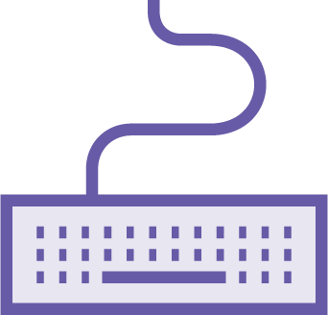
Feel free to make mistakes!

Slide 4
Up Next:
A future full of containers…

